Slide 1


Team leader : Dhanush S
Title of the Idea : Smart card based shared micro-mobility (E-Maas).
Email ID : dhanush@hylomobility.com
Mobile No : 9360632774
Aadhaar no : 643992091508
Name in Aadhaar : Dhanush S
Address : 732/9 Type 1 qtrs, C F Estate, Aruvankadu, The Nilgiris - 643202
Category: Student

Slide 2
Other Students Work in the project/ Idea
Name : Chanduru V M
Aadhar No : 634992561589

Slide 3
MENTOR DETAILS
Mentor Name: Dr M Kathirselvam
Teaching Experience: 9 years
Industrial Experience : nil
Designation : Assistant professor
Department : Mechanical Engineering
Mobile No : 9042897228
Email ID : mkathirselvam@ksrct.ac.in
College: KSRCT
PRASANTHKUMAR PALANI
EX- Mercedes Benz R&D,
Automotive homologation expert,
Head of electric vehicle homologation team of Haritha techlogix,
Active member of EV expert group of ASDC, New Delhi
Corporate Trainer.
SAMPATH KUMAR
EX- Robert Bosch,
15+ years of experience in architect in Embedded systems and IOT hardware technology,
Cloud Automation and Management.

Slide 4
Mandate for Ideas
Marketing & Branding: Innovation related to the customer experience.
Ideation: Innovation related to the product idea & concept.
Technology: Innovation related to the product functionality.
Co-creation: Innovation related to the customer involvement.
Social Innovation: Innovation related to the corporate culture.
Entrepreneurship: Innovation related to through entrepreneurial thinking. Open Innovation: Innovation related to with stakeholders.
Business Model Innovation: Innovation related to the purpose and strategy.
BUSINESS MODEL INNOVATION

Slide 5
SECTOR
1.Agriculture, Rivers & Ocean Produce based industries, fertilizers, Agricultural Implements & Agro processing and any related sub-sector
2.Healthcare & Life sciences, Medical Devices, Pharmaceuticals, Biotech, AYUSH and any related sub-sector
3.Power, Renewables, Electricals, Power Electronics, Energy Efficiency and any related sub-sector
4.Services, Education, Hospitality, Media, Publishing, Entertainment, Design, Wellness, Logistics, Sports and any related sub-sector
5.Miscellaneous Sector (Environment, Forests, Water & Sanitation; Foods, Beverages, FMCG, Consumer Goods; Infrastructure, Construction, Housing; IT, ITES, Electronics, White Goods, Telecommunication; Metals, Engineering, Machinery, Automation and Transportation, Automotive, E Vehicles, Railways, Aviation, UAV and any other sub-sector)
MISCELLANEOUS SECTOR (E Vehicles)

Slide 6
The Objective of the idea is to develop a shared mobility service for in campus commuting which is independent of smart phone to provide ease of access and data security for the users. The Concept is to develop an indigenous IOT hardware device that works on the Smart card Technology that can be integrated with users ID card. In future when deploying into public shared mobility users can easily use their multipurpose mobility card (National Common Mobility Card) to access our shared mobility service.
Concept & Objective

Slide 7




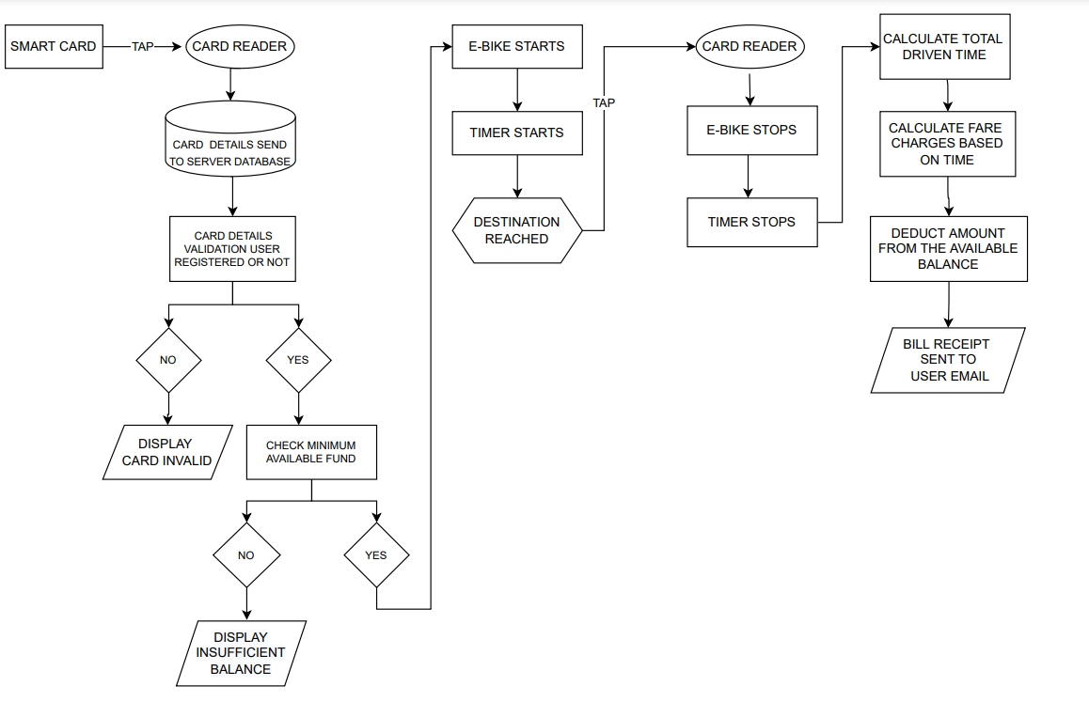
Block Diagram
Get the smart card
Recharge the card
Tap the card
Enjoy the ride

Slide 8
Whether your idea involves use of existing intellectual property or not, give brief details there of
The implemented technology is been is used in various industries for different applications .
Our idea of smart card technology is new to the shared mobility industry.
The use case and the working principal is totally new and is a patentable product.

Slide 9

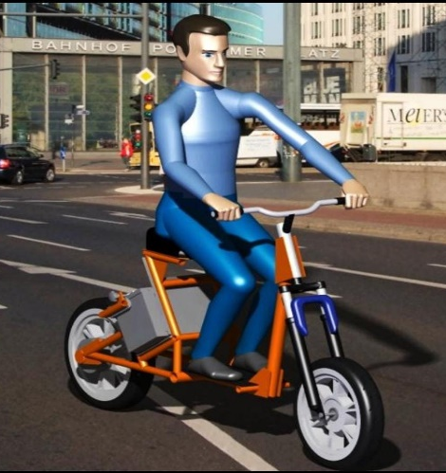
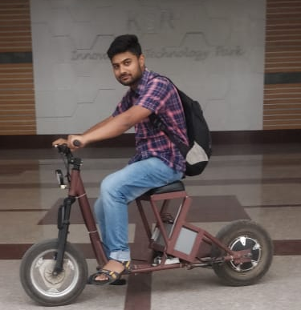
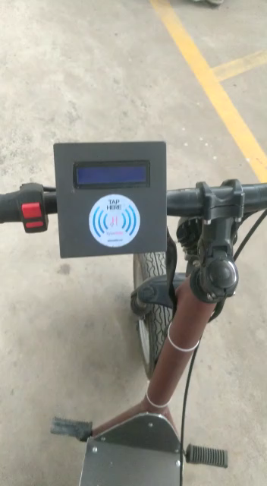
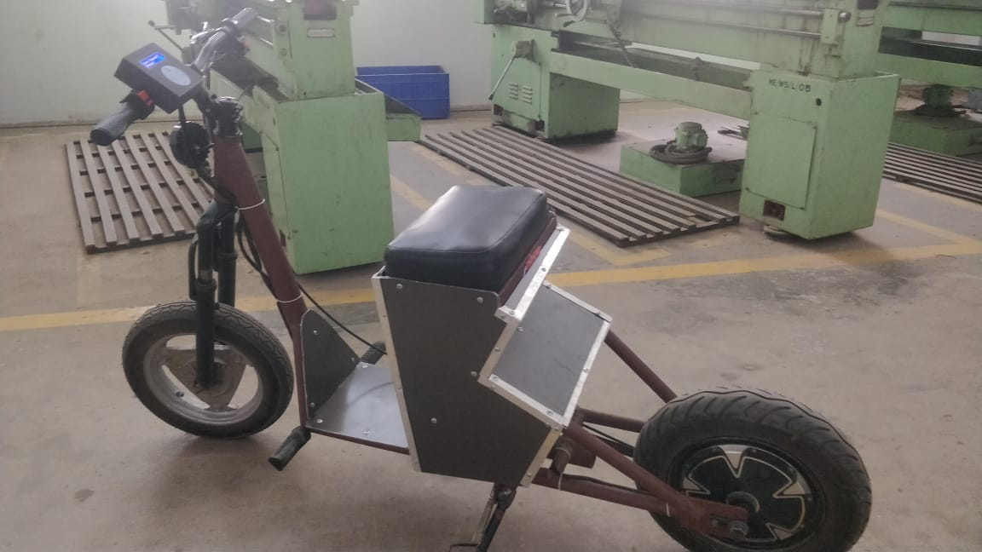
Current Development status of innovation

Slide 10
Expected time of completion of idea
First level basic working prototype is been completed.
Currently working on development of MVP and go to market product (Expected time to complete Market product : 7 to 9 months).

Slide 11
Please give activity-wise break-up as mentioned below
Particular/Item | Total idea project cost (Rs. In lakh) | Amount GOI assistance (Rs. In lakh) | Incubatee share (Rs. In lakh)
Technology related Expenditure towards machine usage charges etc., Electricity charges, Procurement of raw material , testing/Calibration charges, other charges essential for development of idea Max (10.00) lakh. | 10 | 8 | 2
Charges for mentor/handholding supporting team Max (3.00) lakh. | 3 | 2.5 | 0.5
Travelling Expenses or any other item not coverd as above may be allowed as per need for development of the idea Max ( 2.00) lakh. | 2 | 1.5 | 0.5
Total idea/project cost (Rs in lakh):15
Total GOI Assistance required (Rs in lakh): 12
Total Incubatee share (Rs in lakh): 3

Slide 12
Budget Plan

Slide 13
Idea may fulfill the following, inter-alia, parameters
Novel & innovative value
More than 60% of Indian people travel less than 8km a day and use their private vehicle to commute.
Our Micro- mobility solution will be useful for these people.
Reduce the traffic conjunction and carbon emission.
Smart card technology easy integrated with users Id card.
2. Useful to the society
Shared Micro mobility will be a best suitable alternative for the in-campus commuting and also in first & last mile commuting.
It is affordable and easily accessible by all.
Every individual need not have to spend on purchasing own vehicle.

Slide 14
3. Reduce cost of living, product or process
The cost of purchasing own vehicle is neglected
The cost of fuel is neglected
The maintenance cost of the vehicle is neglected
All these put together saves lot of money for a individual.
4. Improve quality of life and provide convenience to living standards
Since the Mobility service is through electric powered vehicle there is zero emission and pollution free.
People need not worry about stuck in traffic jam.
The technology and the product is developed to be user friendly for all age group users.

Slide 15
5. Clean & green energy initiative
E-Maas is a great initiative for clean and green energy.
Improves quality of living.
6. Innovative value proposition of products/ services being offered
User is free from sharing their own data in the public mobility space.
Need of smart phone to access public mobility service is removed.
User feel safe, secure and easy to use.

Slide 16
7. Ease of availability of the resources used in the product to ensure ease of scalability
The Components used are easily available in the Indian Market at a cost effective range.
The worry about of lead time is reduced since available locally.
Transportation cost and time is reduced.
8. Commercial/Technical/Financial viability
The development of the technology is technically feasible.
Since all the components are available locally its financially viable.
Its easy to Commercialize with lots of govt supporting EV Schemes and there is a huge demand for this service.

Slide 17
9. Climate mitigation measures
The air quality of the ecosystem is improved by reducing carbon emission.
The carbon mitigation would result from more electric vehicles entering the fleet while lower-carbon energy sources become widely available.
E-Maas technology allows the global fleet to achieve approximately 40% lower carbon emissions than a highly efficient conventional combustion fleet (and 70% lower carbon than a business-as-usual fleet) in 2050.
10. Status of intellectual property
Yet to apply ( Document preparation going on)

Slide 18
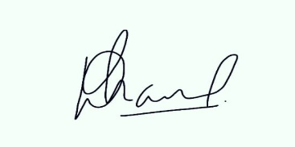
Assurance
I assure that the Ideas which is not already exist
I assure that the Ideas is not infringement/theft
I assure that the Ideas which are not against established scientific theories/norms
SIGNATURE

Slide 19
THANK YOU

